Slide 1
FYP Installation

Slide 2
Download and Install
1. Download and Install Python 3.7
(https://www.python.org/downloads/)
2. Download and Install XAMPP (https://www.apachefriends.org/download.html)
3. Download and Install ANACONDA
(https://www.anaconda.com/)

Slide 3
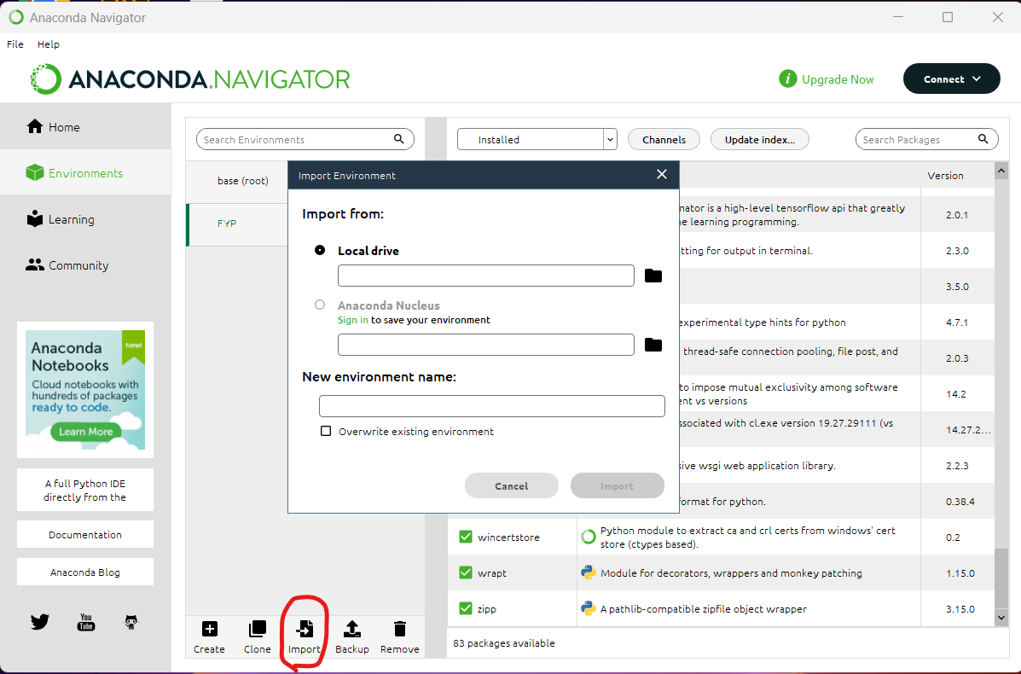
Virtual Environment Setup
Open ANACONDA Navigator app
Select Environments tag and click import
3. Select file ("Main System\Public Machine\python_environment.yaml") for the import

Slide 4
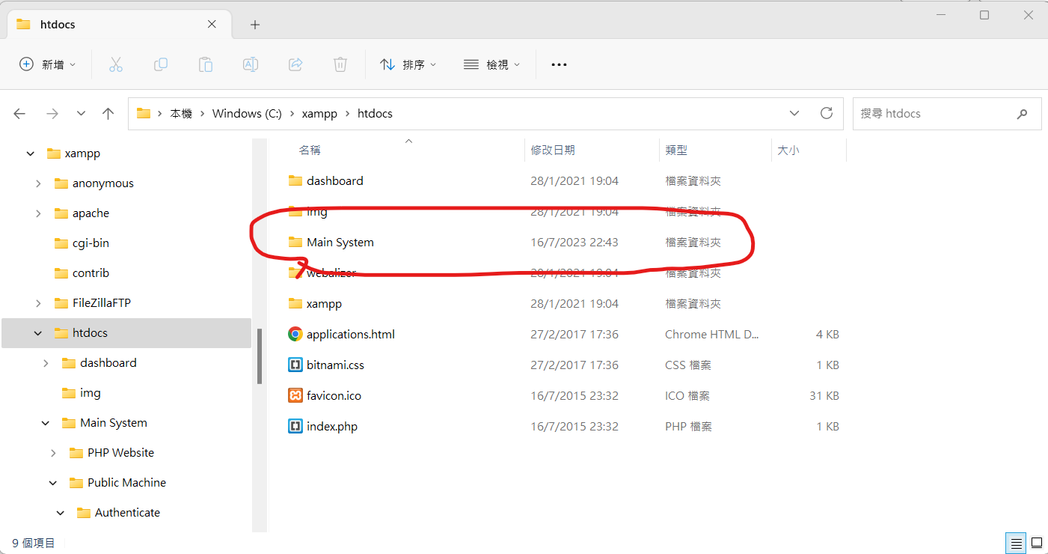
PHP File Setup
Open downloaded XAMPP path and past the source code into ‘htdocs’ file
Default path: C:\xampp\htdocs

Slide 5
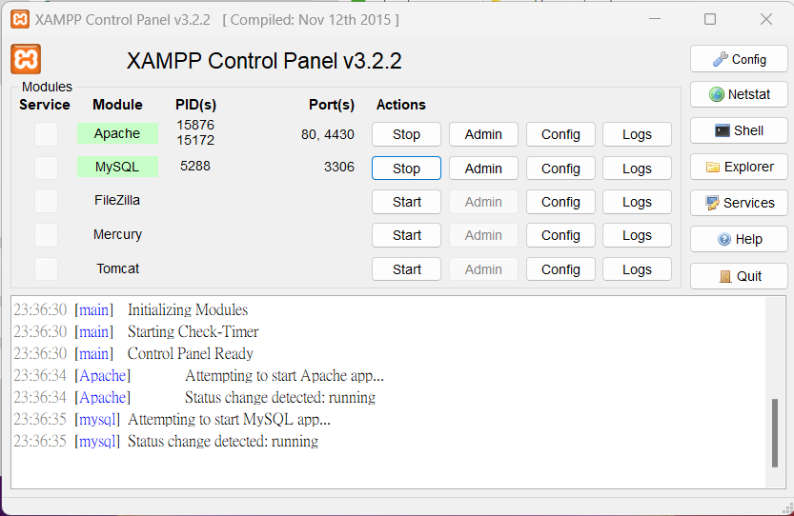
Server and Database Setup
1. Open XAMPP Control Panel app and start ‘Apache’ and ‘MYSQL’

Slide 6
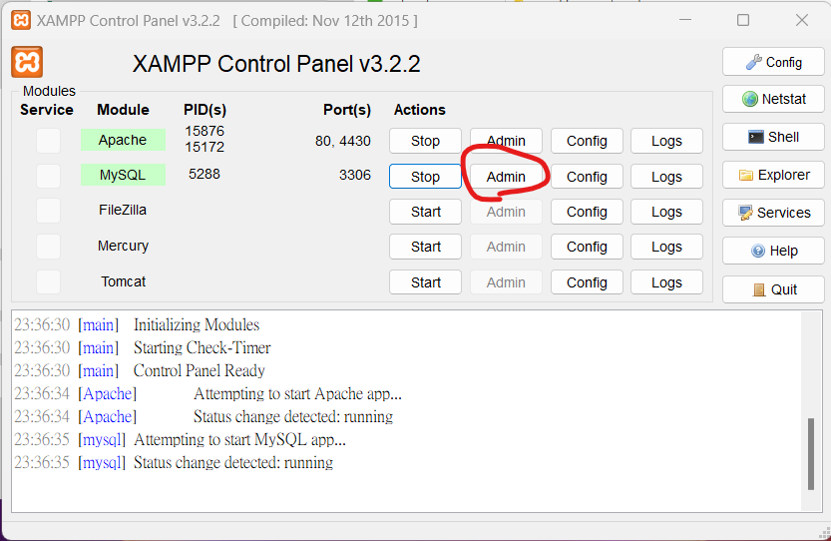
2. Click ‘MySQL’ Admin button

Slide 7
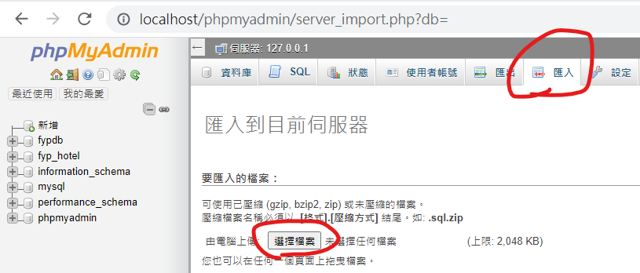
3. Select import tag and click ‘choose file’ button
4. Select and import ("Main System\fyp_hotel.sql")

Slide 8
To run website
http://localhost/Main%20System/PHP%20Website/index.php

Slide 9
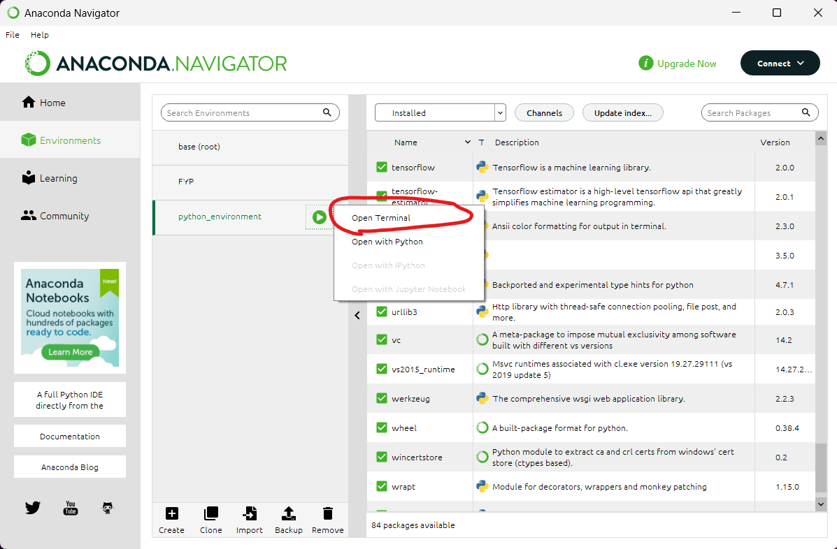
To run public machine
Open ANACONDA Navigator app
Select Environments tag and open terminal with imported virtual environment

Slide 10
3. Go the pasted source code path (C:\xampp\htdocs\Main System\Public Machine)
4. Run command “python UI.py”

Slide 11
To run unlock door Testing
After finished custom the authenticate gesture using public machine
You can run “python unlockPING.py” to test the PING and unlock the room door

